Slide 1
How Player Height Affects the NBA
Analysis Team:
Lindsay Reynolds, Nick Sheets

Slide 2
Motivations and Hypothesis
We are both basketball fans and interested in basketball statistics
We wanted to explore if height has any relation to salary and stats in the form of points, rebounds, and assists
Alternative Hypothesis:
If an NBA player is taller, then the points averages, rebounds averages, and salary are greater than players who are shorter
If an NBA player is taller, then the player’s assist averages are less than players who are shorter
Null Hypothesis:
If a player’s height is greater, then player’s salary, points, rebounds, and assists stats are not affected

Slide 3
Questions ASKED
Does height impact performance (ppg, rebounds or assists per game)?
Do taller players score more often?
Do taller players grab more rebounds?
Do taller players have more or fewer assists per game than shorter players?
Does height impact salary?
Do taller or shorter players make more money?

Slide 4
Data Sources Used
Websites used: Kaggle and Basketball-Reference
Data used:
Kaggle: NBA Players, Justinas Cirtautas
https://www.kaggle.com/justinas/nba-players-data
Find heights of players
Find yearly averages by player for points, rebounds and assists
Limitation - there is no data for blocks
Sports Reference LLC: Basketball-Reference.com "2020-21 NBA Player Contracts" (4/22/2021)
https://www.basketball-reference.com/contracts/players.html
Used to gather data on players’ salaries
Center for Disease Control, 2021
https://www.cdc.gov/nchs/fastats/body-measurements.htm
Used to pull average male height in U.S.

Slide 5
Data ExpLoration
Issues anticipated for the CSV files chosen for analysis
Only a partial season of stats for 2019-20 in Stats CSV
No data on blocks per game
Heights listed in centimeters
Player names are like Stephen Curry\curryst01 in Salary CSV
Large values for salaries
Notes:
Notes on data sets abandoned:
Issues with data set usability
Several NBA stats CSV files on Kaggle only for download as SQLite (abandoned)
Another with over 600,000 rows of game data, but with Game ID not date (abandoned)

Slide 6
Data cleanup
CSV files read in as Pandas DataFrames
Updates and additions
Listed player names consistently, filtered out unnecessary columns and renamed/reordered columns as needed
Narrowed scope of stats analysis to 3 recent seasons:
2016-17, 2017-18, and 2018-19
Added columns for height in inches, salary in millions

Slide 7
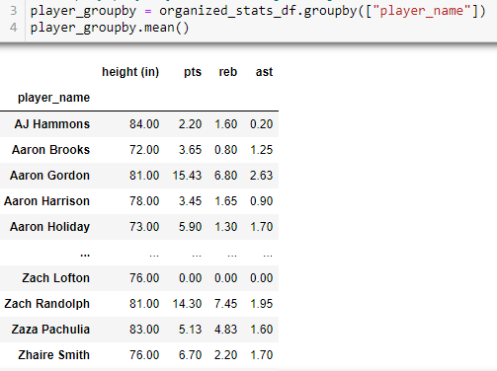
Data cleanup
Created a data frame that included player name and personal info such as height
Averaged player stats across the three seasons in a new data frame
Merged these together to one data frame, with one row per player, and a total of 748 different players

Slide 8
Data cleanup
Next merged the data frame with the salary data frame
Left merge for same set of unique players (748 expected)
Number of rows increased to 766 following merge
Suspected some players had duplicate rows in Salary CSV
Example

Slide 9
Data Cleanup
Dropped rows for player duplicates in salary data frame (contains 748 rows again, one per player)
List contains 748 players once again
Dropped players in salary data frame without 2020-21 salaries (no longer salaried players in NBA)
Only 324 different players across the three seasons have salary data for analysis
Note large change in short amount of time, as players cycle out and new ones replace them
Cleanup complete, and three files were saved for use in the analysis notebook
player_stats_breakout_by_season.csv
player_stats.csv
player_stats_with_salaries.csv

Slide 10
Data Analysis
What is the average height of players in the NBA?
Mean = 78.87 inches (around 6’ 6″)
Median = 79 inches (6’ 7″)
Mode = 81 inches (6’ 9″)
Across the three seasons analyzed there were 81 players in all that were 81 inches tall (6’ 9″)
Average male height in US = 5’ 9″ (CDC, 2021)

Slide 11
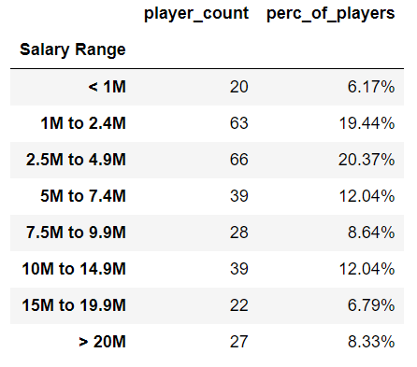
Data Analysis
About 40% of players in our dataset are making between 1M and 5M in 2020-21
SALARY BINNING

Slide 12
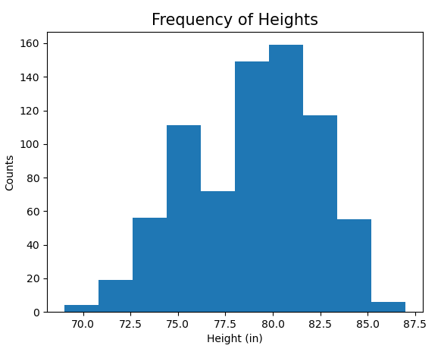
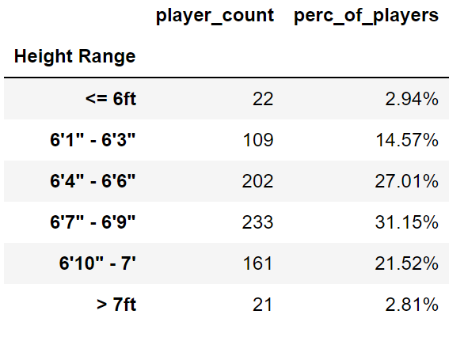
Data Visualizations
HEIGHT HISTOGRAM
HEIGHT BINNING
Nearly 1/3 of the players are 6’7″ to 6’9″
Around 58% are 6’4″ to 6’9″
NormaltestResult(statistic=1.2860512176624757, pvalue=0.5256994544947969)

Slide 13
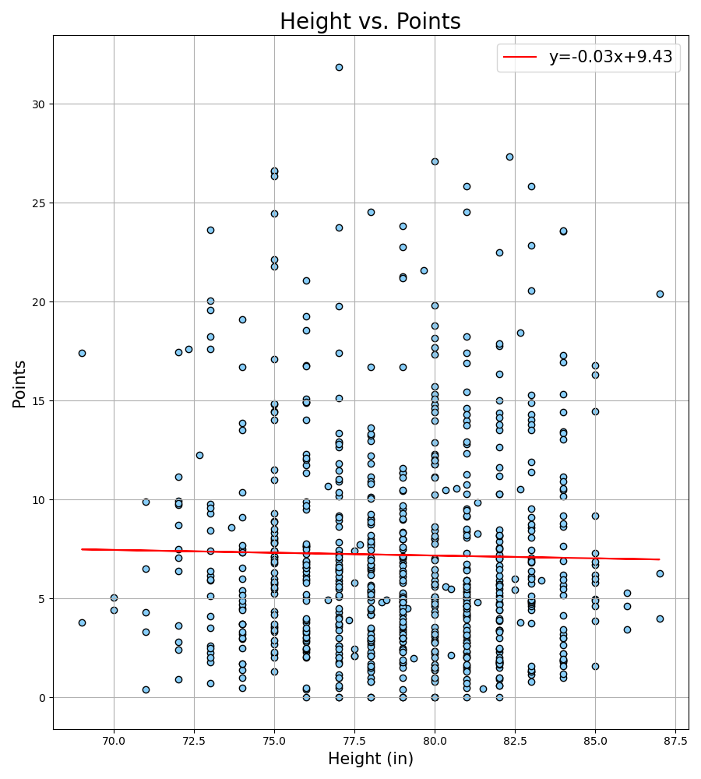
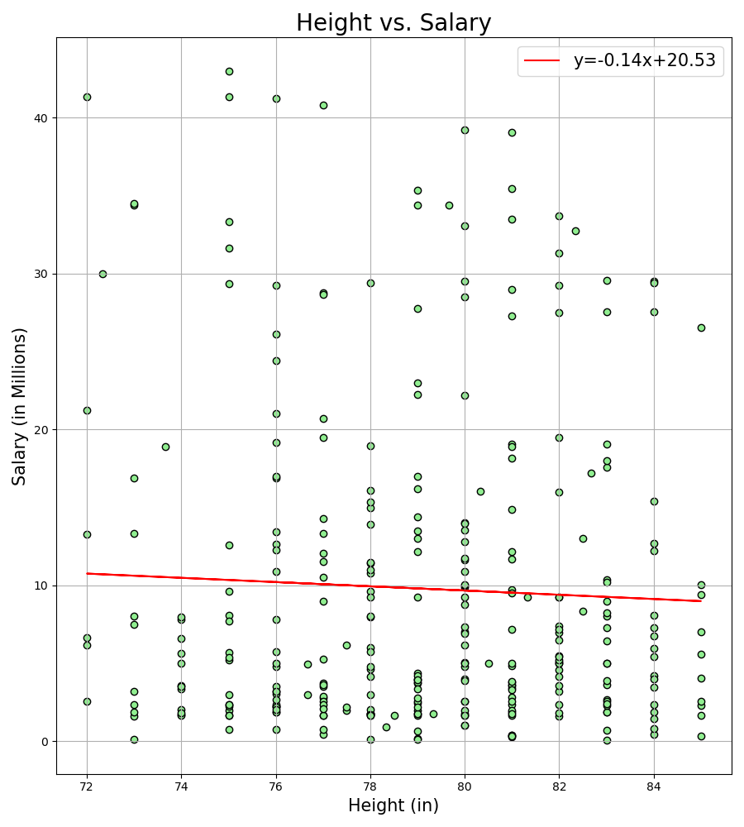
Data Visualizations
HEIGHT vs. POINTS
&
HEIGHT vs. SALARY
pearsonr results: (-0.017377411665314996, 0.6351390828365829)
pearsonr results: (-0.044071115087400095, 0.4291784196774443)

Slide 14
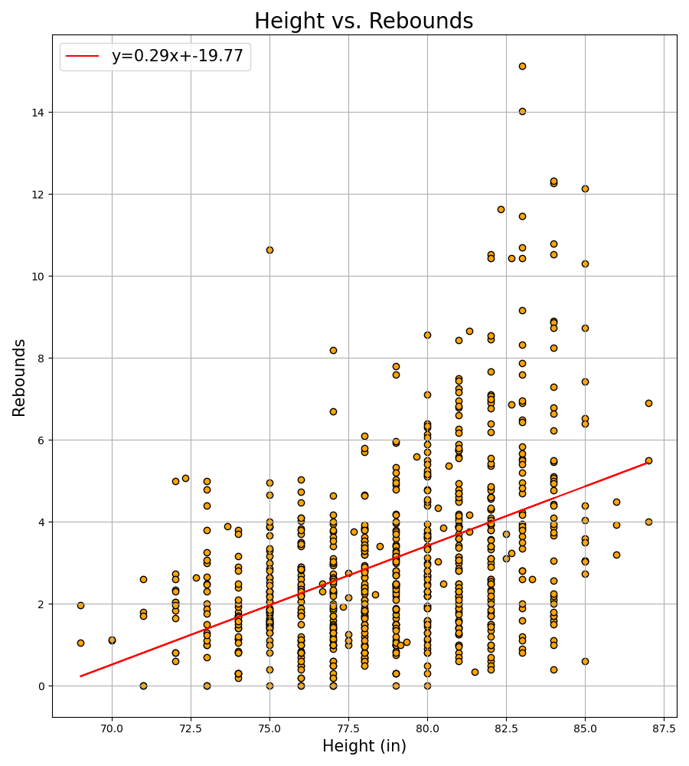
Data Visualizations
HEIGHT vs. REBOUNDS
For players of all heights
pearsonr results: (0.43453524023725276, 8.423531901409829e-36)

Slide 15
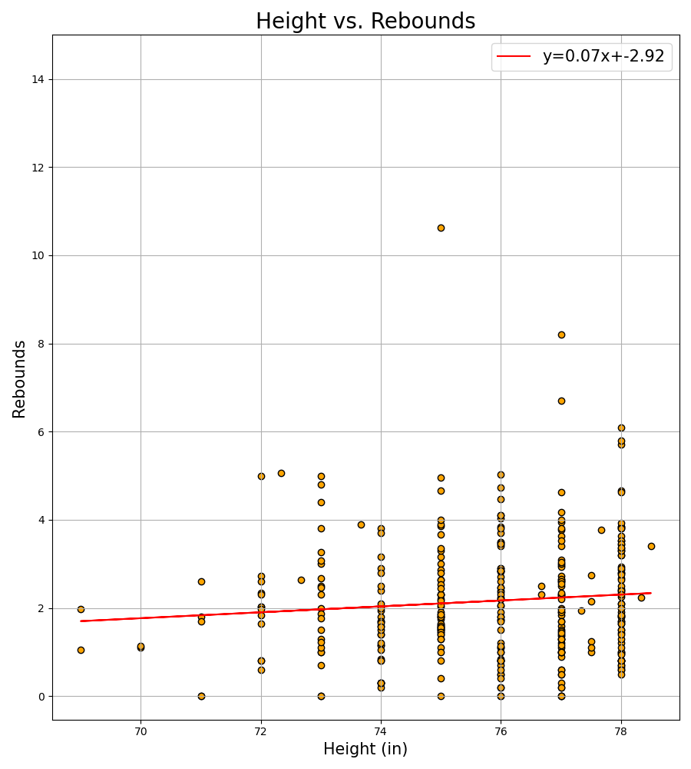
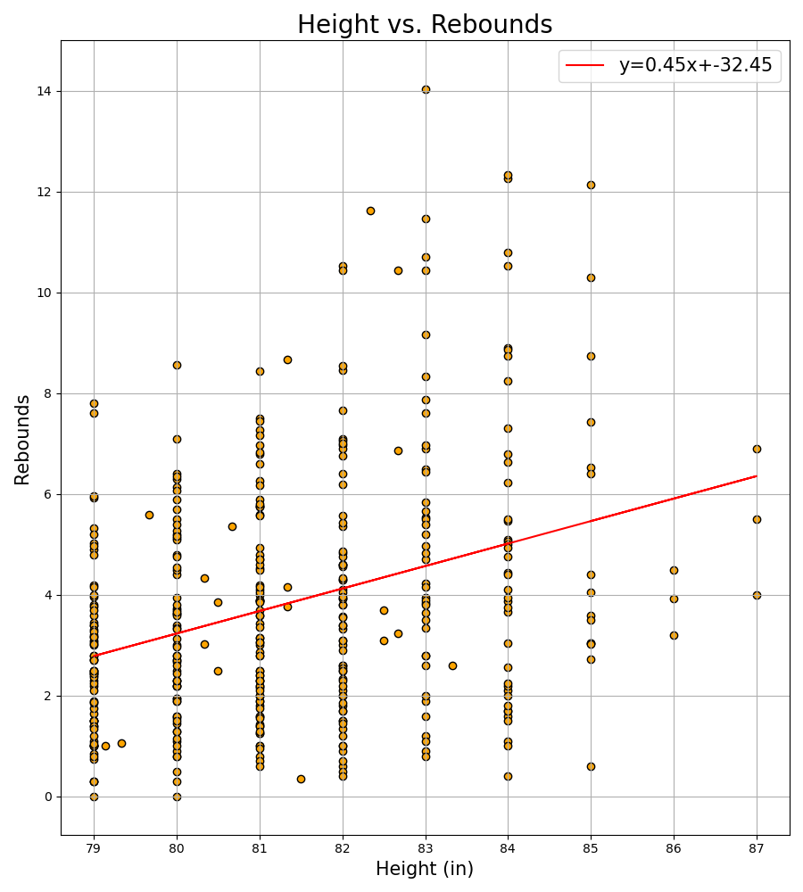
Data Visualizations
HEIGHT vs.
REBOUNDS
Split between players
of height < mean
& players of height >= mean
pearsonr results: (0.09624547228754901, 0.07856345203318187)
pearsonr results: (0.3216356492219352, 2.1519075913158547e-11)

Slide 16
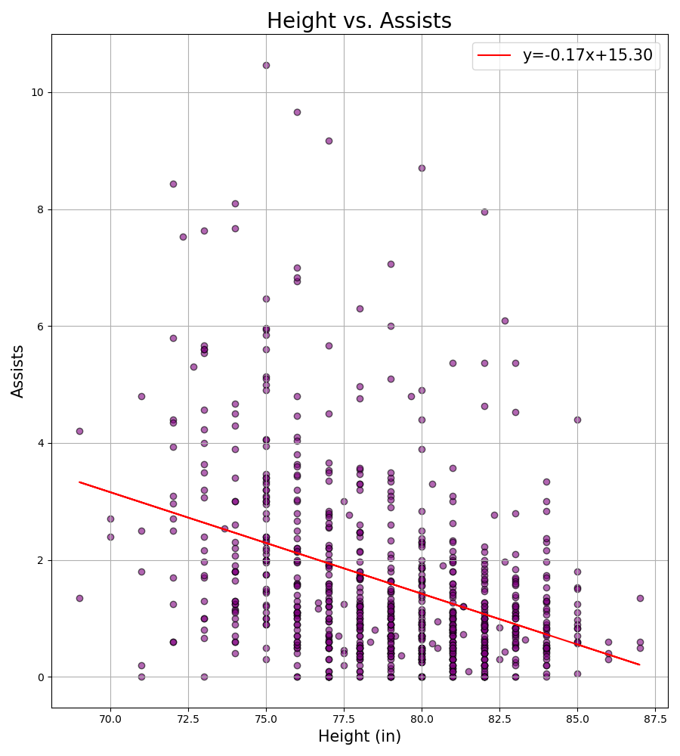
Data Visualizations
HEIGHT vs. ASSISTS
pearsonr results: (-0.3698558763535108, 1.1604091735536877e-25)

Slide 17
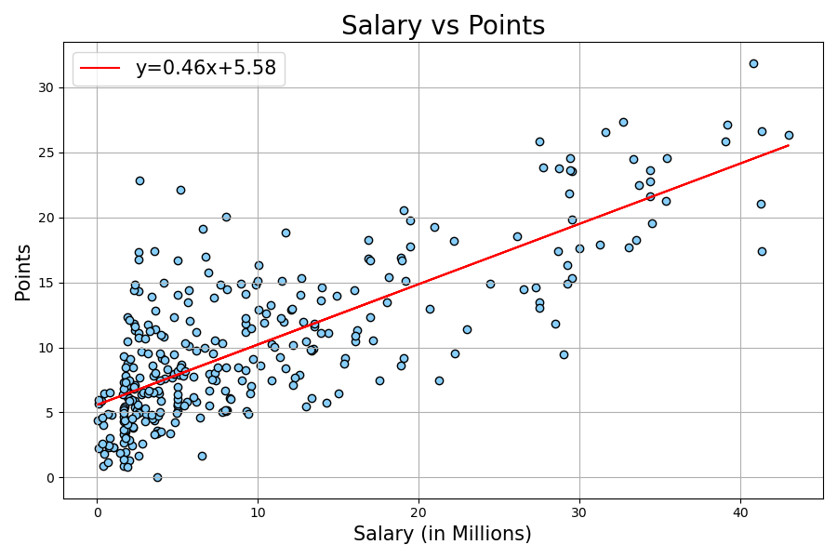
Data Visualizations
SALARY vs. POINTS
pearsonr results: (0.7696157006414956, 1.0565978011907831e-64)

Slide 18
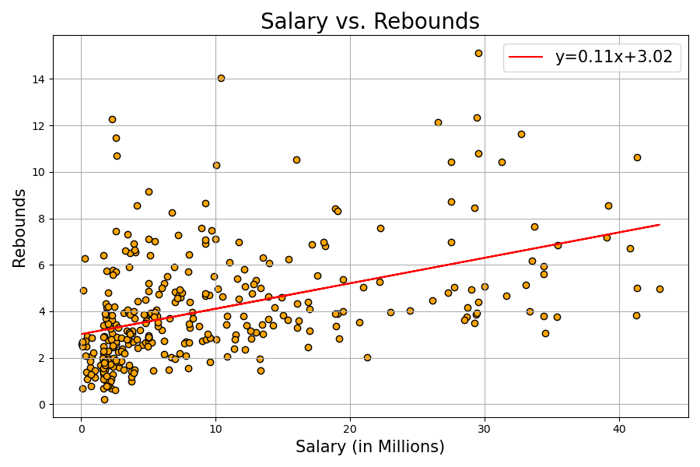
Data Visualizations
SALARY vs. REBOUNDS
pearsonr results: (0.45025171413569315, 1.405623025197144e-17)

Slide 19
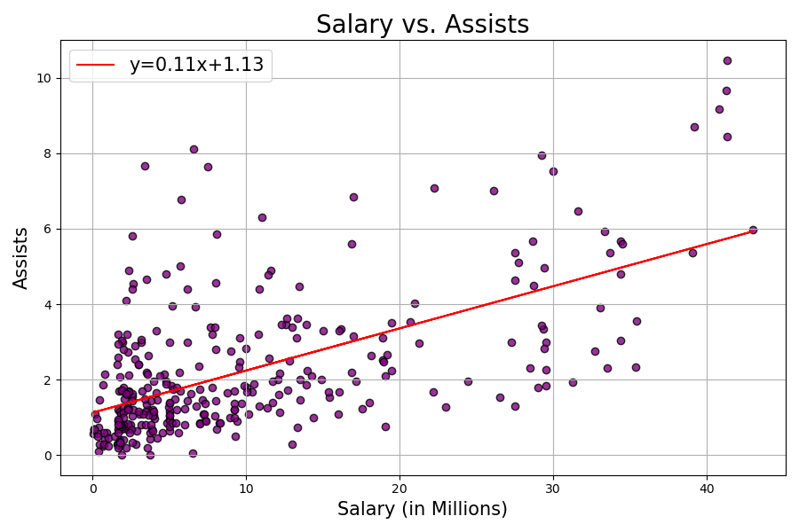
Data Visualizations
SALARY vs. ASSISTS
pearsonr results: (0.601504128402172, 2.9064123213974663e-33)

Slide 20
summary of findings
Height does not affect points or salary, but can affect the amount of rebounds
The data does not suggest taller players score more points
The data shows taller players grab more rebounds, this to be true with a strong positive correlation
Taller players have less assists than smaller players, showing a negative correlation
The data shows height does not affect players’ salaries
There is no correlation with height and salary, the linear regression line is fairly flat

Slide 21
Final thoughts
Additional data that could have been analyzed
Blocks per game
Average heights for each team
Does height have any impact on wins and losses?
What is the average height of women in the WNBA as compared to average height of women in the U.S?
Could have looked at the pip install available to pull stats for the NBA

Slide 22
Audience participation (if Time ALLOWS)
If anyone would like to test our abilities to pull data from our Pandas DataFrames
Choose Player, College or Country
Choose All or Average – Do you want all the rows in our data for your players or only the average of them?
Up to 50 rows of results are displayed

